Slide 1


INSTITUTE FOR ADVANCED COMPUTING AND
SOFTWARE DEVELOPMENT, AKURDI, PUNE
A Presentation on Image CAPTION GENERATOR USING DEEP LEARNING
PG-DBDA
Sept-2022
Project Guide
Dr. Shantanu Pathak
Project By-
Ajit Yadav(229302)

Slide 2
PROBLEM STATEMENT
To develop a system for users, which can automatically generate the description of an image with the use of CNN along with LSTM.

Slide 3
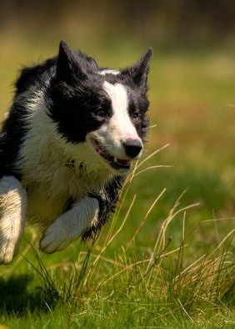
Example
when image is passed as an input to the model, it should be able to generate captions in natural language such as
“ Black and white color Dog is running through grass ”

Slide 4
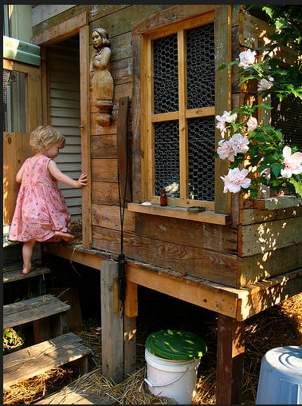
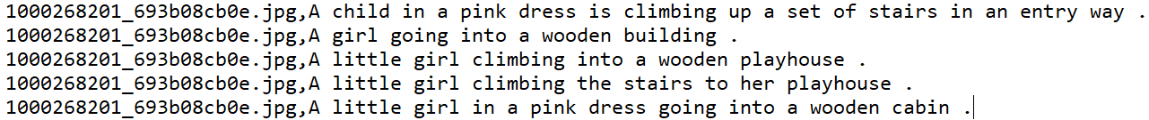
About Dataset
Flickr8K Dataset from Kaggle
Contains 8,091 images
Text file that contains 5 different caption for each image

Slide 5
LIBRARIES USED
TENSORFLOW
KERAS
PICKLE
NLTK
FLASK
PIL
MATPLOTLIB

Slide 6
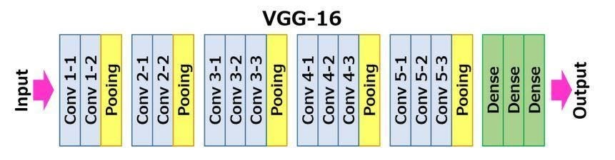
Pre Trained Model -VGG16

Slide 7
Extracting Image Features
Resizing the images to 224*224
Converting the image pixels to a numpy array
Preprocessing the image for VGG16 model
Extacting the features using predict() of VGG16

Slide 8
Loading Captions Data & Preprocessing
Creating mapping of image to captions
Pre-processing steps:
Converting to lowercase
Deleting digits, special chars, additional spaces, etc.
Deleting Adding start and end tags to the caption

Slide 9
Tokenizing the text data
Using Tokenizer() for tokenization
Using tokenizer.word_index for assignment of indexes

Slide 10
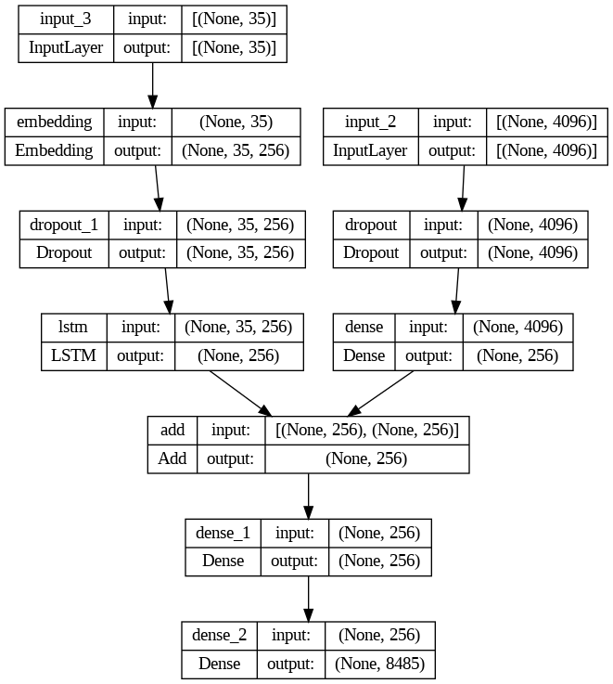
Preparing Model

Slide 11
Train Test Split
Training the model
Generating Captions for the Image
Validating with test data using BLUE score

Slide 12
DEPLOYING AS A WEB APPLICATION
We have used FLASK to deploy our project as a REST-API in the form of a web application.
FLASK is a web application framework of PYTHON used mostly to deploy machine learning models.

Slide 13
Creating python file for running Server
Image_caption.py
Tokenizer.pkl
Features.pkl
Model.h5
caption_this_image()
app.py
render_template(‘index.html’)
@app.route('/', methods = ['POST'])

Slide 14
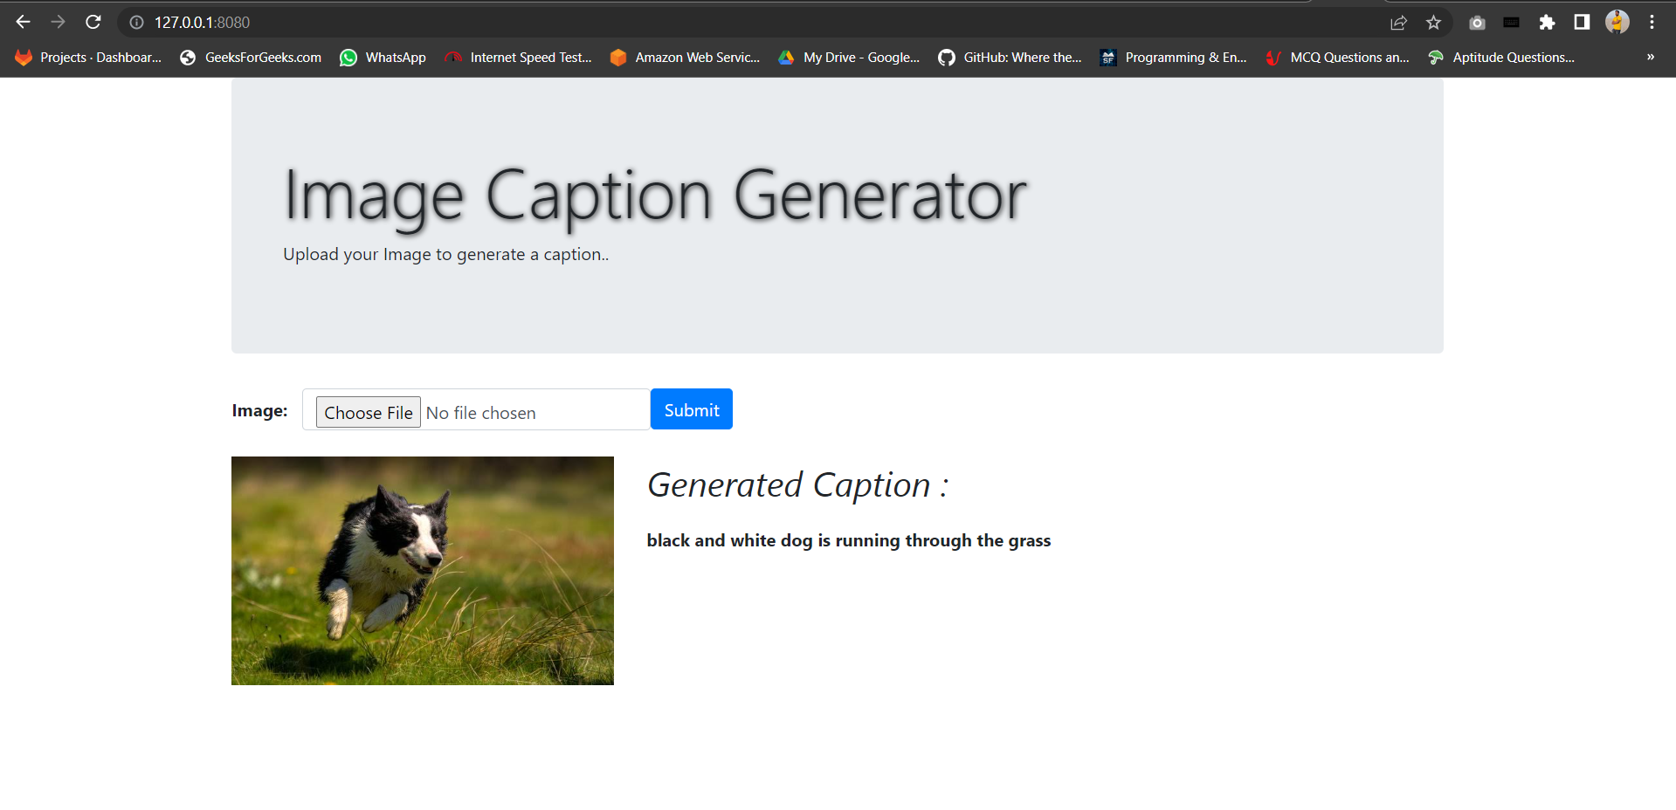

Slide 15
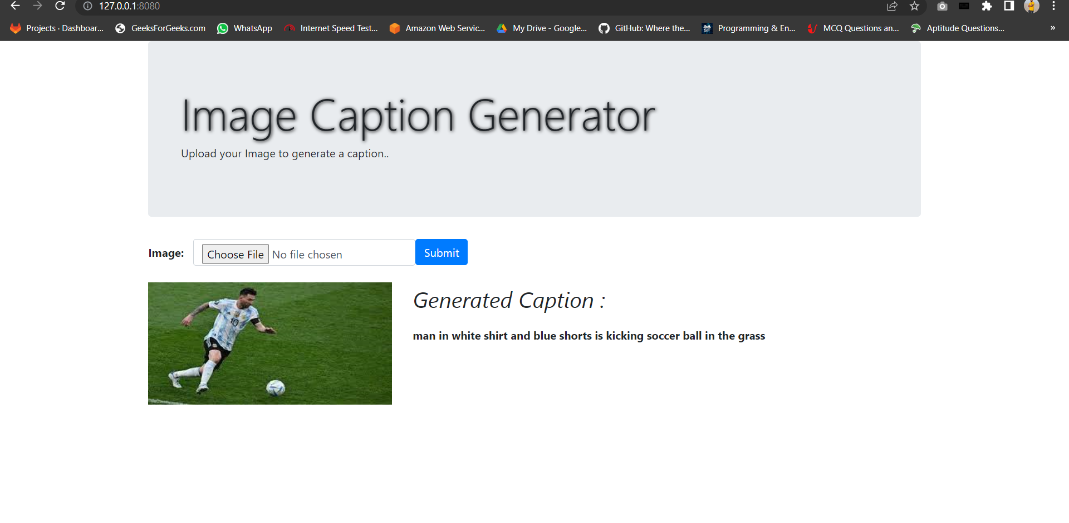

Slide 16
Applications and Future scope of Image Caption Generator
It can be used to assist the blind using text-to-speech.
It can be used to convert captions for images in social feed as well as messages to speech which will enhance social medial experience of users.
It can also be used for educational purposes as young children can be assisted about recognition of objects and learning the English language.
It is also helpful in field of robotics as environmental insights can be provided through natural language representation.
It can also be used for image searches and indexing purposes on internet if images present on the internet have captions.

Slide 17
THANK YOU

